Slide 1


Tutorial: Advanced FHIR Shorthand
Mark Kramer
Chief Engineer for Health Technical Center
MITRE Corporation
Chris Moesel
Principal Software Systems Engineer
MITRE Corporation
May, 2020

Slide 2
Topics
Extensions
Slicing
Caret Paths
Rule Sets, Mixins
Invariants
Mapping
Exact Equality

Slide 3
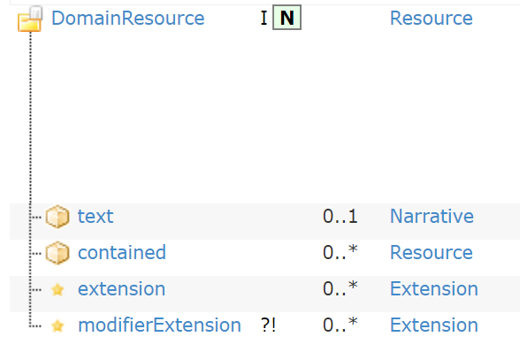
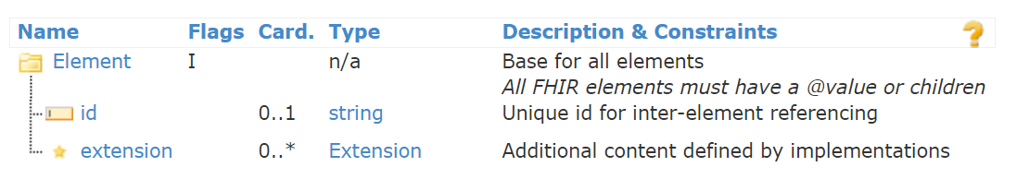
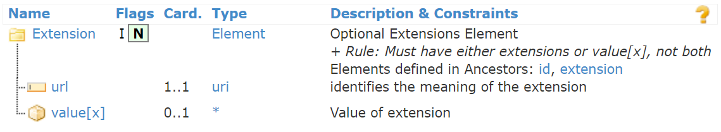
What is an Extension?
Every Resource has an extension array at the top level.
Every element has an extension array
Extension arrays contain Extension elements.
An Extension either has a value[x] or further extensions
"Adding an extension" really means constraining an extension array to contain a certain type of extension.

Slide 4
Extensions Summary
Inline Extensions:
* extension-path contains
extension1 card1 flags1 and
extension2 card2 flags2 ...
Example:
* extension contains
treatmentIntent 0..1 MS and
terminationReason 0..* MS
Stand-Alone Extensions:
* extension-path contains
extension1 named name1 card1 flags1 and
extension2 named name2 card2 flags2 ...
Example:
* extension contains
RadiationDosePerFraction named dosePerFraction 0..1 and
RadiationFractionsDelivered named fractionsDelivered 0..1 MS and
TotalRadiationDoseDelivered named totalDose 0..1
name inside profile
stand-alone name

Slide 5
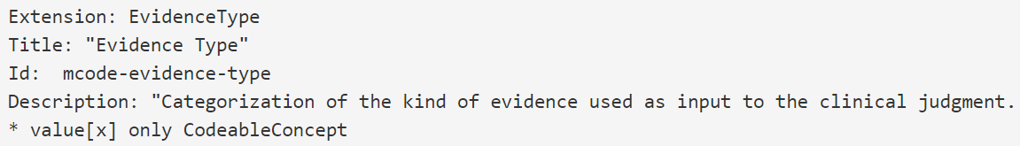
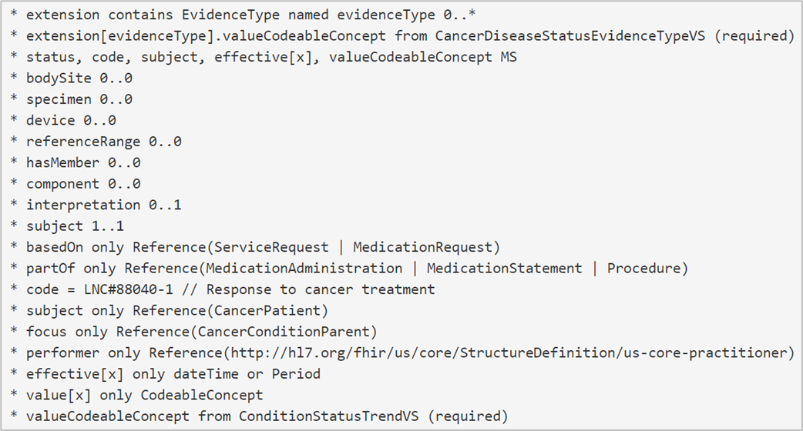
Defining and Using Stand-Alone Extensions
Define the extension using the "Extension" keyword. No parent is needed because FSH knows it is an Extension.
Now, in the profile, add it to an extension array using "contains".
This grammar also applies to an extension defined in another IG (use its URL).
Once added, the extension can be further constrained by referring to the element in the extension array by name:

Slide 6
Defining and Using In-Line Extensions
Defining the extension in-line does not require an "Extension" structure.
The resulting extension will not have a separate StructureDefinition.
The "contains" statement is similar but does not name an extension.
* extension contains evidenceType 0..*
* extension[evidenceType].value[x] only CodeableConcept
* extension[evidenceType].valueCodeableConcept from CancerDiseaseStatusEvidenceTypeVS (required)

Slide 7
Slicing
Similar to extensions -- the objective is to say what can go into an array
The array elements will not be Extensions
Arrays we typically want to slice:
Backbone elements, such as Observation.component
Arrays of complex data types, such as Identifier or Address, such as Practitioner.identifier
Arrays of references to resources, such as Observation.hasMember
Divide slicing into three steps:
(1) Identify the slices,
(2) Define each slice, and
(3) Specify the slicing logic

Slide 8
Slicing 1: Identify the slices ("contains")
* array-element-path contains
slice-name1 card1 flags1 and
slice-name2 card2 flag s2 ...
* component contains
geneStudied 0..* MS and
genomicDNAChange 0..1
* hasMember contains
PrimaryTumorCategory 0..1 and
RegionalNodesCategory 0..1 and
DistantMetastasesCategory 0..1
Each element must match the datatype of the array
components
Observations (profiled)

Slide 9
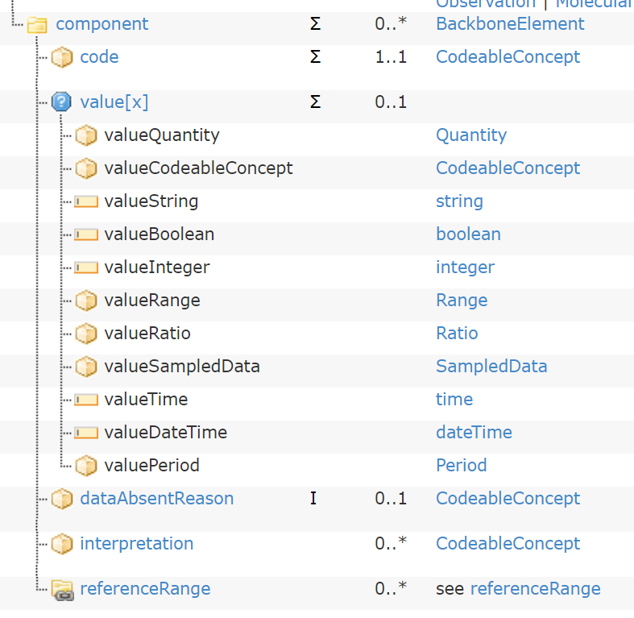
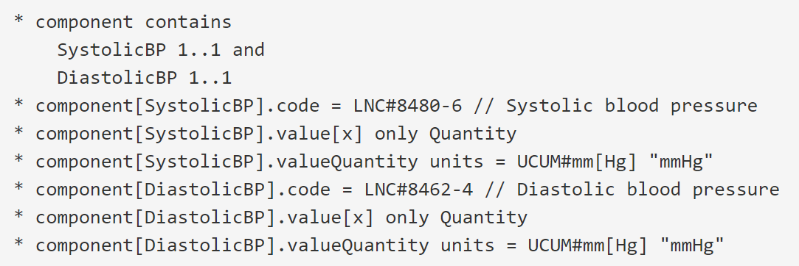
Slicing 2: Define Each Slice
If the array type is resource reference(s), then the slices are defined either in an existing resource profile, or any one you define in your project (similar to "stand-alone" extensions)
If a backbone element or complex data type, then it must be defined inline.
Example: Observation Component

Slide 10
Slicing 3: Define Slicing Logic
Discriminator -- something that reliably distinguishes the slices
Given an instance with something in the array, how do we know what slice it belongs to?
Slicing logic is found in the ElementDefinition part of the StructureDefinition
Get at the attributes using caret logic
Example: Slice Observation.component on Observation.component.code
* component ^slicing.discriminator.type = #pattern // or #value, #profile
* component ^slicing.discriminator.path = "code" // any FHIRPath expression
* component ^slicing.rules = #open // additional elements are ok
* component ^slicing.ordered = false // by default, array elements in any order
* component ^slicing.description = “Slice pattern for component.code" // optional

Slide 11
Choosing a Discriminator
This is a bit out of scope... it is a FHIR issue, not a FSH issue
Types:
#value -- implies discrimination on a single value, such as a code (not coding)
#pattern -- implies discrimination on the specified element (system and code)
#profile -- rarely a good idea, since it requires complex validation
Path: where FHIR should find the value or pattern

Slide 12

Caret Paths for StructureDefinition Metadata
Caret (^) gives direct access to elements in StructureDefinition
Useful for setting metadata elements, such as publisher, jurisdiction, experimental:
StructureDefinition also contain an ElementDefinition for every element and subelement:
valueInteger ^minValueQuantity
hasMember ^slicing.discriminator.path
hasMember[PrimaryTumorCategory] ^short
Example: Set the description attribute on the binding of communication.language:
* communication.language ^binding.description = "This binding is dictated by US FDA regulations."
minValueQuantity is a property of ElementDefinition

Slide 13
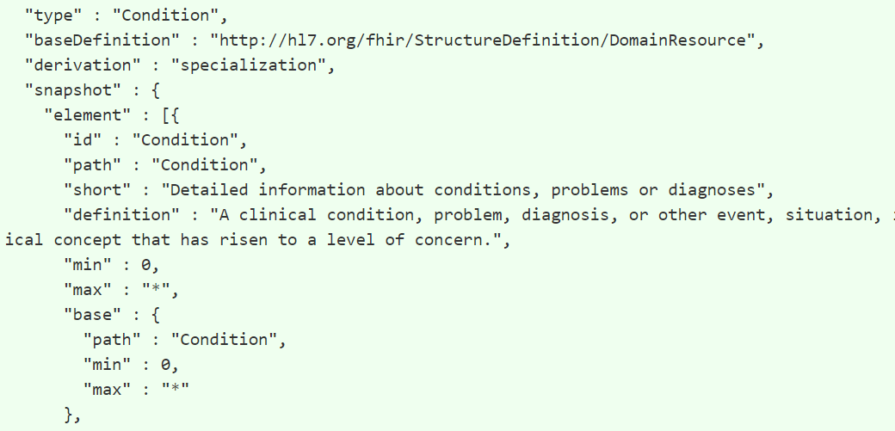
The Oddball Dot Caret Path
The first ElementDefinition in any StructureDefinition refers to entire item
To refer to properties of this particular "self" element, use dot (.) as the element path
Example: Provide a short description for an extension (defined in the “self” ElementDefinition):
* . ^short = "US Core Race Extension"

Slide 14
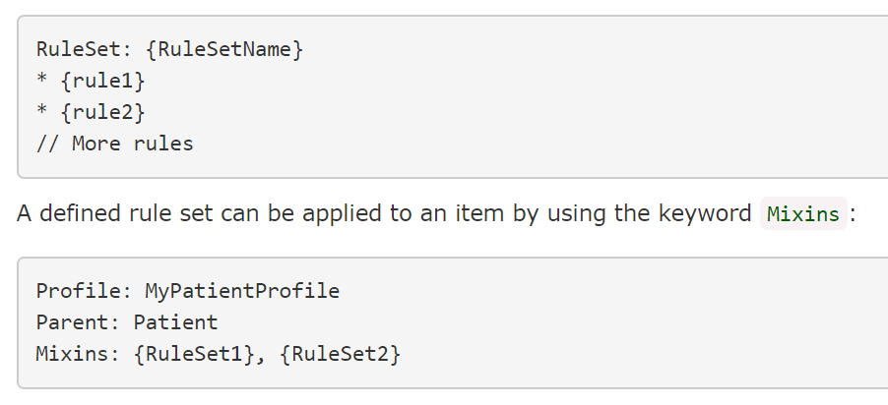
Rule Sets and Mixins
Provides ability to define free-floating rules and apply them to a compatible target
The same rule set can be used in multiple places
An example could be to set the same metadata on every StructureDefinition
Mixin rules are applied before local rules

Slide 15
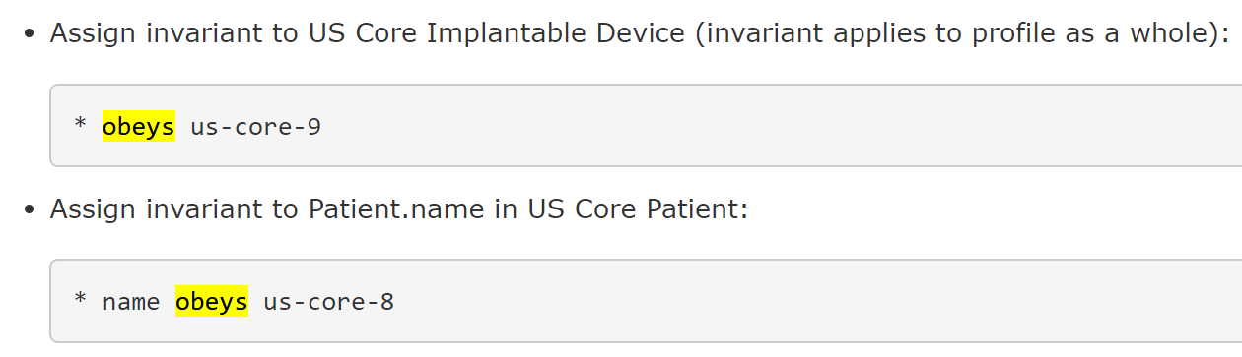
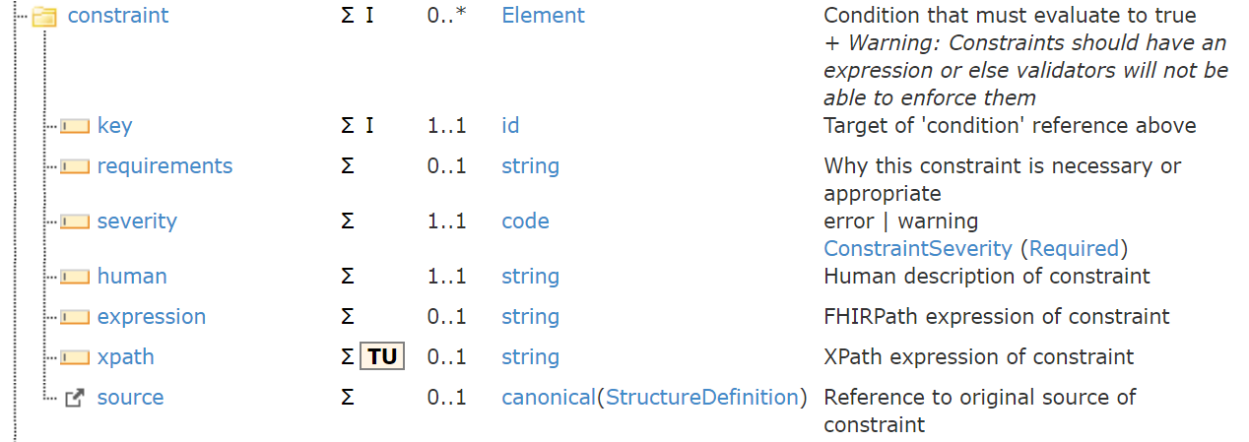
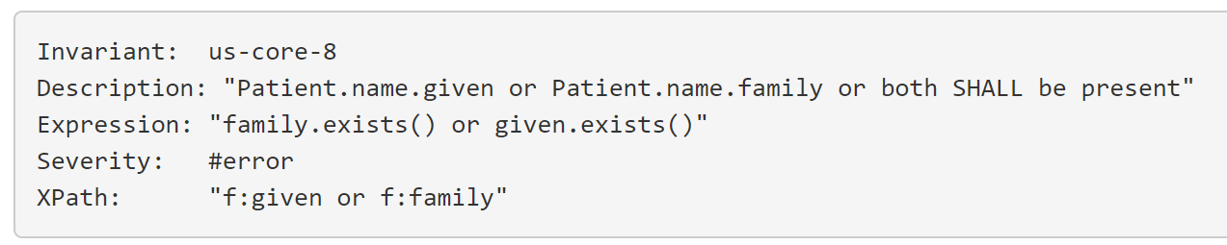
Invariants and "obeys"
Invariants represent logical constraints on values in a resource
"obeys" rule populates ElementDefinition.constraint
adds constraint to "self" ElementDefinition (remember dot caret?)
adds constraint to "name" ElementDefinition

Slide 16
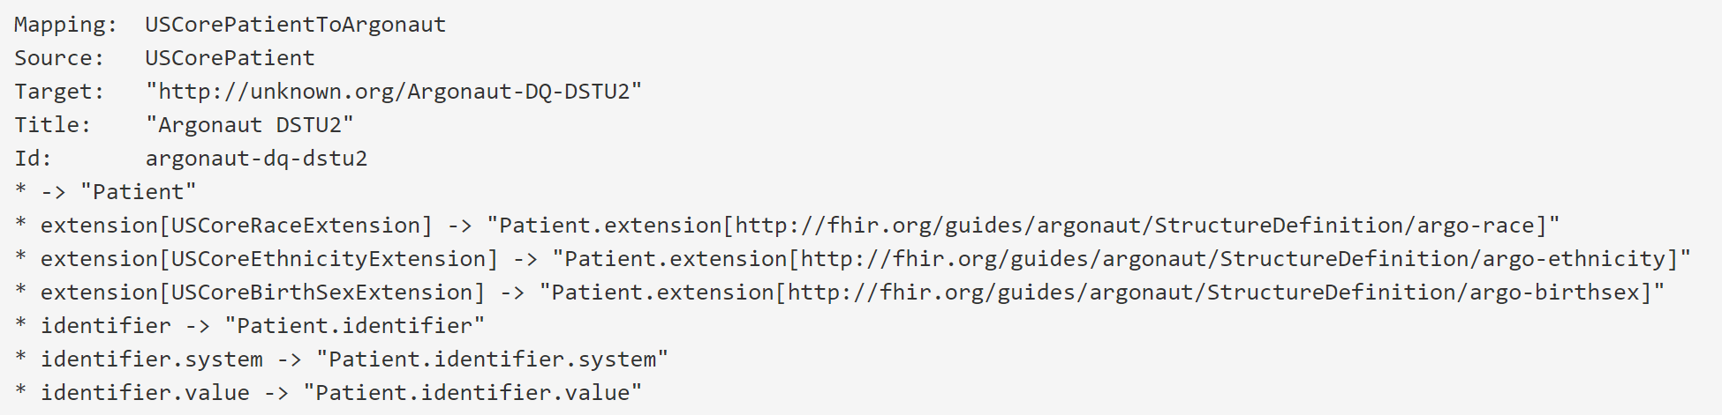
Mapping
Mappings are an optional part of SDs that can be provided to help implementers understand the content and use resources correctly
Mappings are informative and are not to be confused with computable mappings provided by FHIR Mapping Language or the StructureMap resource
In FSH, mapping rules are part of a separate Mapping definition

Slide 17
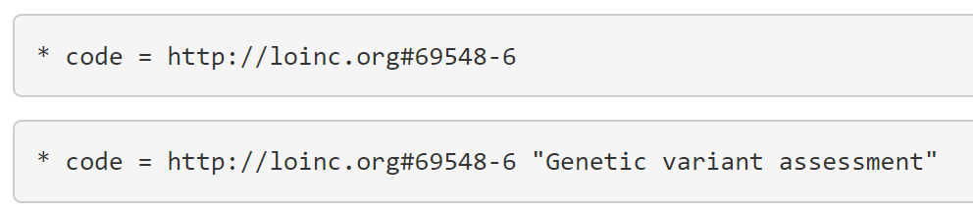
Assignments Statements in Profiles
In profiles and extensions, values represent the minimum criteria for conformance
In the context of a profile, the first statement signifies an instance must have (1) the system http://loinc.org and (2) the code 69548-6 to pass validation.
The second statement says that an instance must have (1) the system http://loinc.org, (2) the code 69548-6, and (3) the display text “Genetic variant assessment” to pass validation.
Typically, only the system and code are important conformance criteria, so the first statement (without the display text) is preferred in a profiling context.
In an instance, however, the display text conveys additional information useful to the information receiver, so the second statement would be preferred.

Slide 18
Forcing an Exact Match (Profiles and Extensions)
* {path} = {value} (exactly)
"(exactly)" indicates conformance to the profile requires a precise match to the specification, no more or less
NO additional extensions, array elements, codings in CodeableConcept, etc.
Without "(exactly)" any instance that fulfills the pattern is valid -- i.e., no less but possibly more

